Slide 1

Stock Introduction
Group Members:
Karan Patil
Sudarshan Waydande
Yash Jain

Slide 2
About ServiceNow (NOW)
ServiceNow is an American software company based in Santa Clara, California that provides cloud-based solutions to define, structure, manage, and automate services for enterprise operations of the companies
ServiceNow is listed on the New York Stock Exchange and is a constituent of the Russell 1000 Index and S&P 500 Index
Today, ServiceNow has a market cap of approximately $120 billion with subscription revenue totaling $1.512 billion for the third quarter of 2022
ServiceNow makes money via subscription fees and professional services
ServiceNow have in total 24 acquisitions some of them are Hitch Works, Intellibot, ElementAI, and more
Competitors of ServiceNow are SAP, Atlassian, Salesforce

Slide 3
Recent news about ServiceNow(NOW)
Digital workflow company ServiceNow could double its India headcount in the next few years as it gears up to double its size globally, chief executive Bill McDermott told ET in an exclusive interview
In a regulatory filing, ServiceNow disclosed that its General Counsel Russell Elmer sold 2.7K shares of common stock on September 19th in a total transaction size of $1.13M
ServiceNow, which provides configurable workflow software for various functions within an organization, on September 21st launched a new version of its main platform that gets much more granular than it has ever been -- even as detailed as guiding a procurement officer through requests for indirect employee purchases.

Slide 4
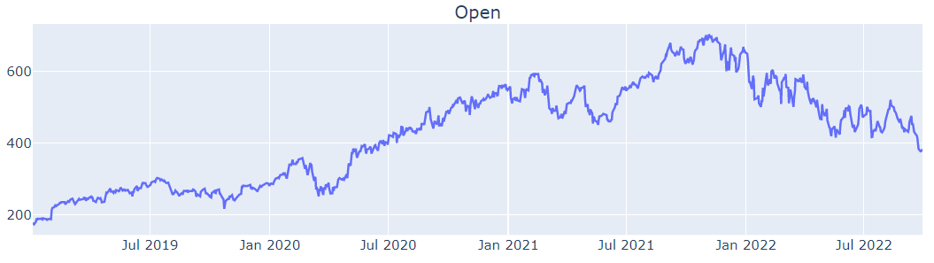
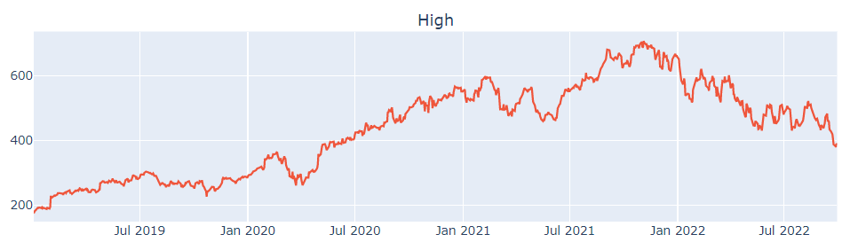
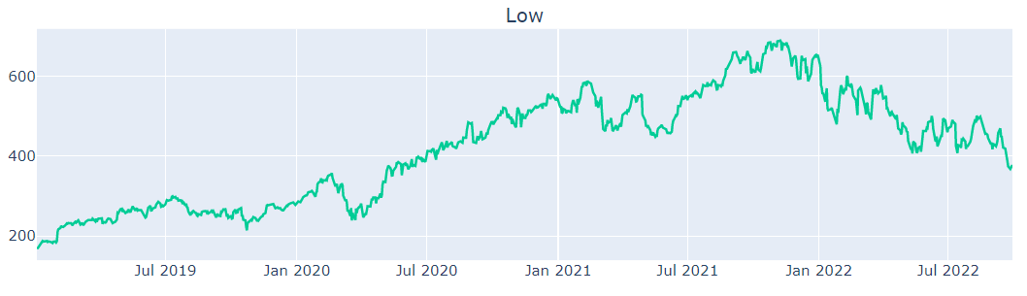
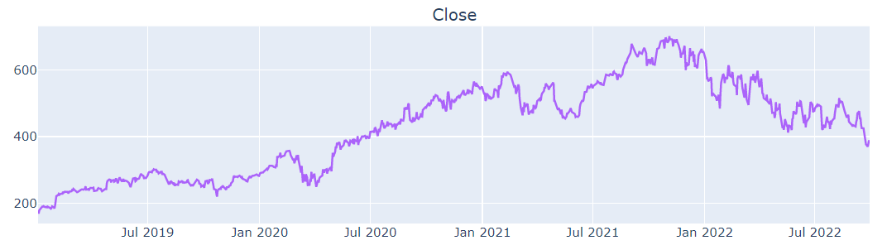
Exploratory Data Analysis(EDA) Line Plots
Open
High
Low
Close

Slide 5
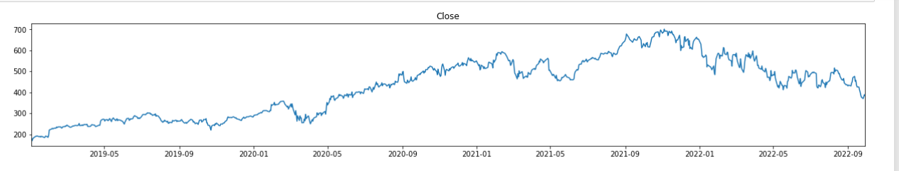
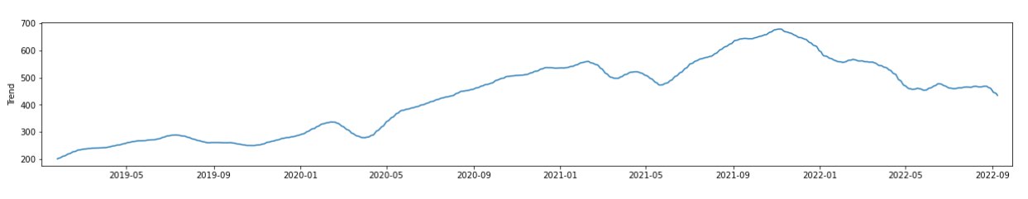
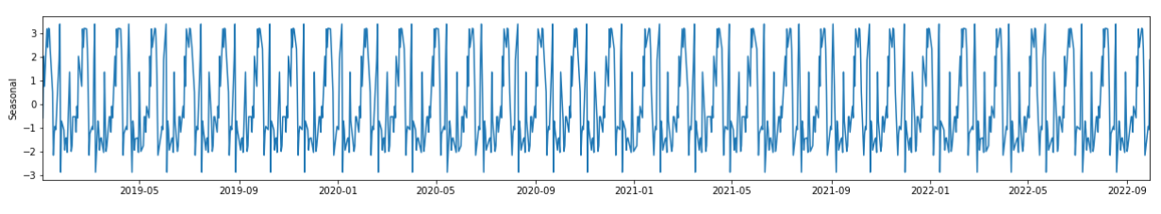
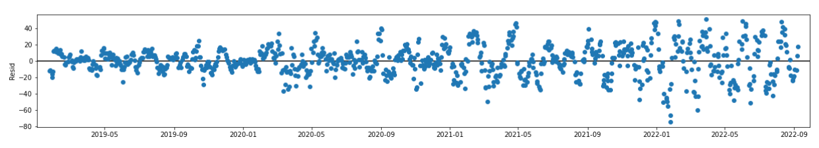
EDA Seasonal decomposition
Observed
Trend
Seasonal
Residual

Slide 6
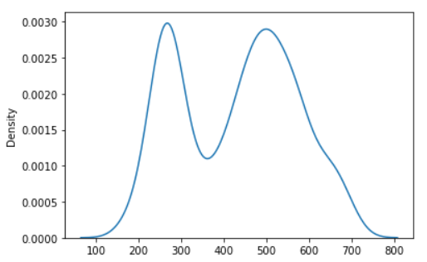
Preliminary Mixture Modelling (KDE)
ServiceNow(‘Adj Close’)
Time Period
Start Date – 2019 -1- 1
End Date – 2022 -9- 30
Kernel density estimate
(KDE)
KDE represents the data
using a continuous
probability density curve
in one or more dimensions

Slide 7
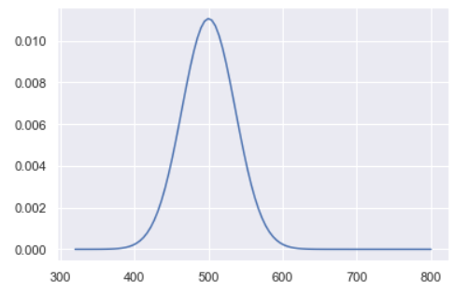
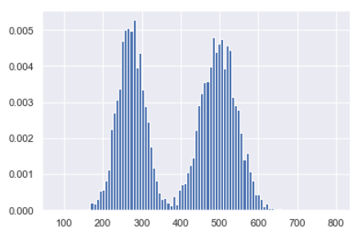
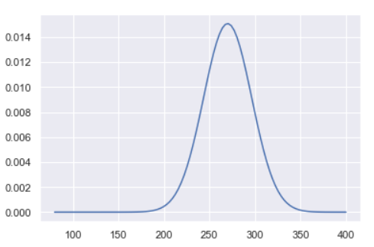
Preliminary Mixture Modelling (Normal Distribution)
Individual Normal Distribution
mu1 = 500
Sigma1 = 2100
mu2 = 270
Sigma2 = 1200
Mixture Normal Distribution
p = 0.55

Slide 8
Thank You

